Slide 1
EOSCsecretariat.eu
Supporting EOSC Governance and its stakeholders

Slide 2

Setting the scene for 2021+
The EOSC Secretariat, effectively delivers 360° support to the EOSC Governance (Executive Board and its Working Groups), and works openly and inclusively together with communities to co-create an all-encompassing European Open Science Cloud
Interim character (2019/20), enabling and advisory approach
Working for and under the supervision of the Executive Board and supporting the Governing Board
Supporting a user-centric EOSC implementation, with the Co-creation budget at the command of the EB

Slide 3
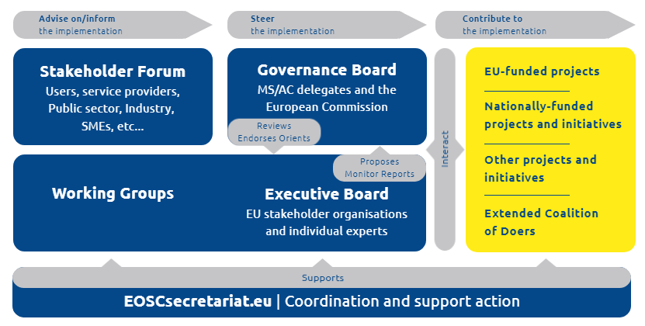

EOSCsecretariat.eu facilitating the EOSC Governance & EOSC projects
Legend:
Supported by the EOSCsecretariat.eu

Slide 4
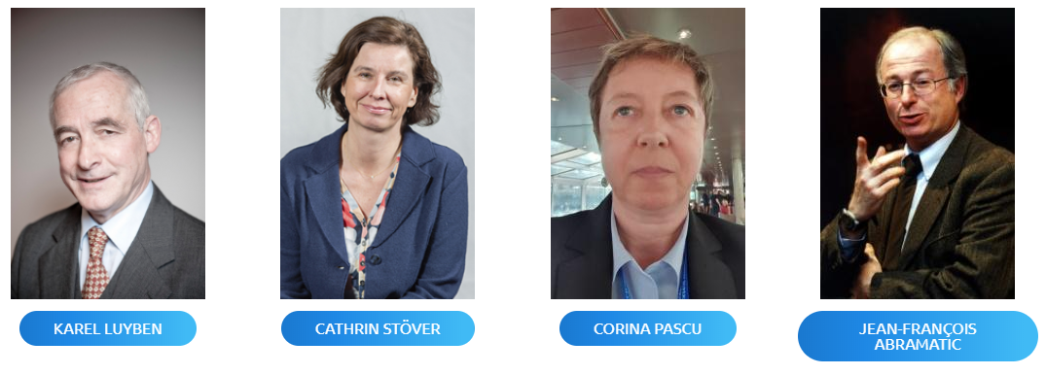
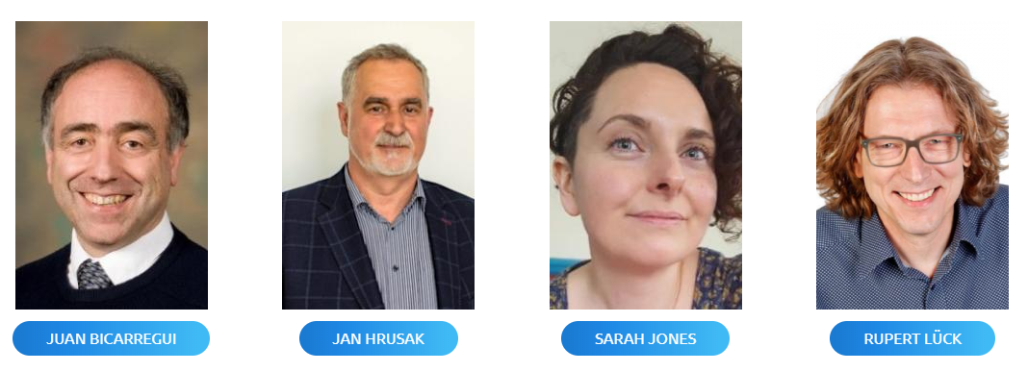

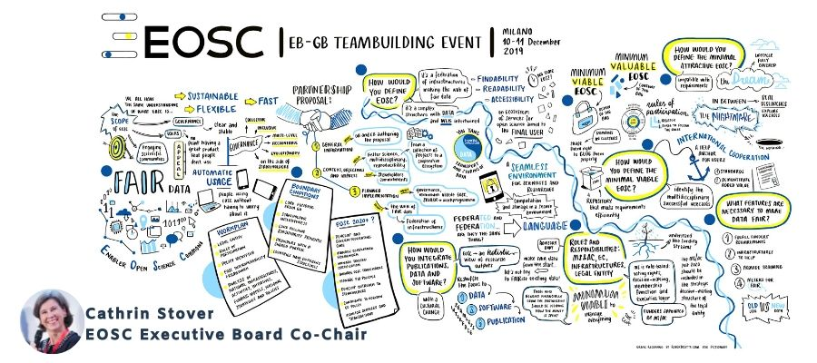
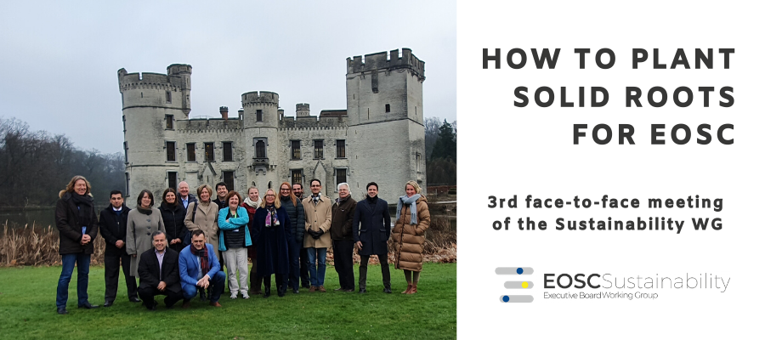

Supporting the EOSC Executive Board and Working Groups
The EOSC Executive Board is formed by 8 representatives of Pan-European research e-infrastructures plus 3 individual experts, nominated by the EC
EOSC Executive Board
The EOSCsecretariat.eu provides support the EOSC Governance by:
Organising monthly EB meetings and periodical team building meetings with the EOSC Executive Board
Regularly publishing and disseminating results and outputs
Collecting feedback from the EOSC Stakeholders
Organising EOSC Stakeholder events to engage the community
Disseminating results and informing the broader public about developments in the EOSC
The main objectives and the timeline for the EOSC Executive Board and Working Groups in 2019-2020 are defined in the following 2 documents:
EOSC Strategic Implementation Plan
EOSC Workplan

Slide 5
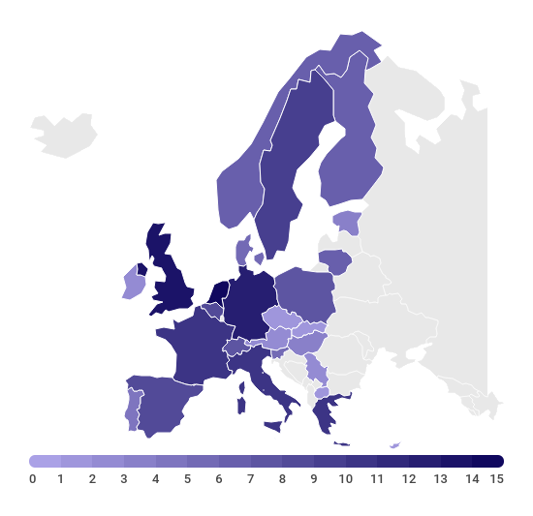

EOSC Working Groups in numbers
Experts represent 28 of the EU Member States and Associated Countries
6 Working Groups
160+ WG Members
10 Active WG Task Forces
EOSC Executive Board
Communications Task Force
Landscape WG
Sustainability WG
International Engagement Task Force
Strategic focus
Close liaison with Governance Board
Rules of Participation WG
Practical implementation focused WGs
Architecture WG
FAIR WG
Landscape
15 male
9 female
RoP
11 male
8 female
Skills & Training WG
Architecture
39 male
3 female
FAIR
16 male
11 female
6 Strategic Priority Areas for EOSC
Sustainability
10 male
8 female
Skills
11 male
21 female

Slide 6

How can you contribute to the EOSC Working Groups?
Submit your project outputs to the EOSC WGs
Contact the EOSCsecretariat at info@eoscsecretariat.eu
Liaise with the EOSC Governance through your project representatives in the allprojects@eoscsecretariat.eu mailing list
Directly contact the WG at their public emails
Inform the WGs about the most relevant contacts in your project/organisation
Join the EOSC Working Groups
Nominate a project representative to join the Architecture or Skills&Training WGs
Join a WG meeting as invited contributor
Join the EOSC Stakeholder Forum events as the EOSC Symposium
Provide feedback on open consultations on the WG outputs
Discuss Horizontal topics through the EOSC Interest Groups
The Architecture and Skills & Training WG are currently accepting nominations from the EOSC Projects
Read more in this blog post by EOSC FAIR WG Chair Sarah Jones on the EOSCsecretariat.eu website

Slide 7
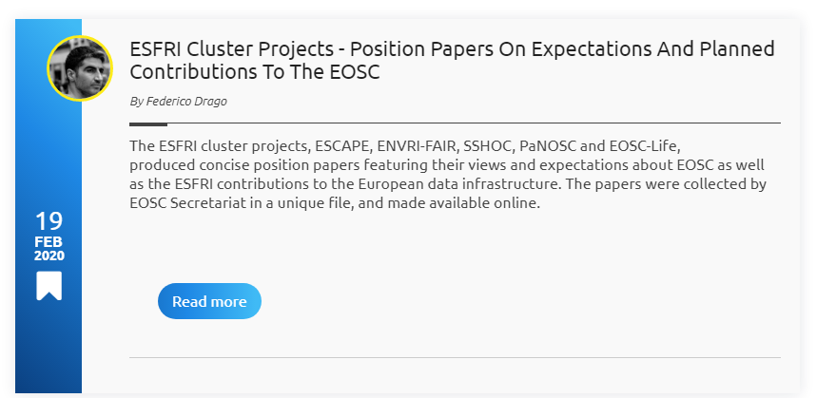
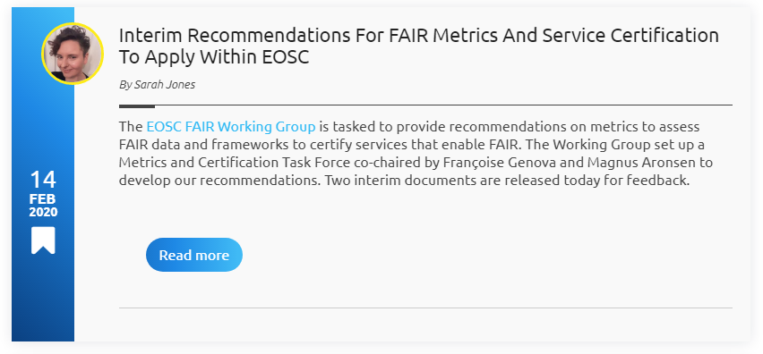




Contribute to ongoing Consultations
The EOSC Liaison Platform an online discussion environment that allows the collection of input and provision of feedback to EOSC governance bodies.
WG documents out for consultation
EOSC FAIR WG
Initial PID Policy
Metrics & Certification
EOSC RoP WG
Draft EOSC Rules of Participation
EOSC Sustainability WG
Tinman report “Solutions for a Sustainable EOSC” – Will be shared with a wider public in the next round of consultations
EOSC & HPC:
Exploring cooperation opportunities between HPC & EOSC: a survey for HPC projects
The EOSC Interest Groups were created to give the EOSC related community the opportunity to collaborate, share information, and discuss EOSC related topics.

Slide 8
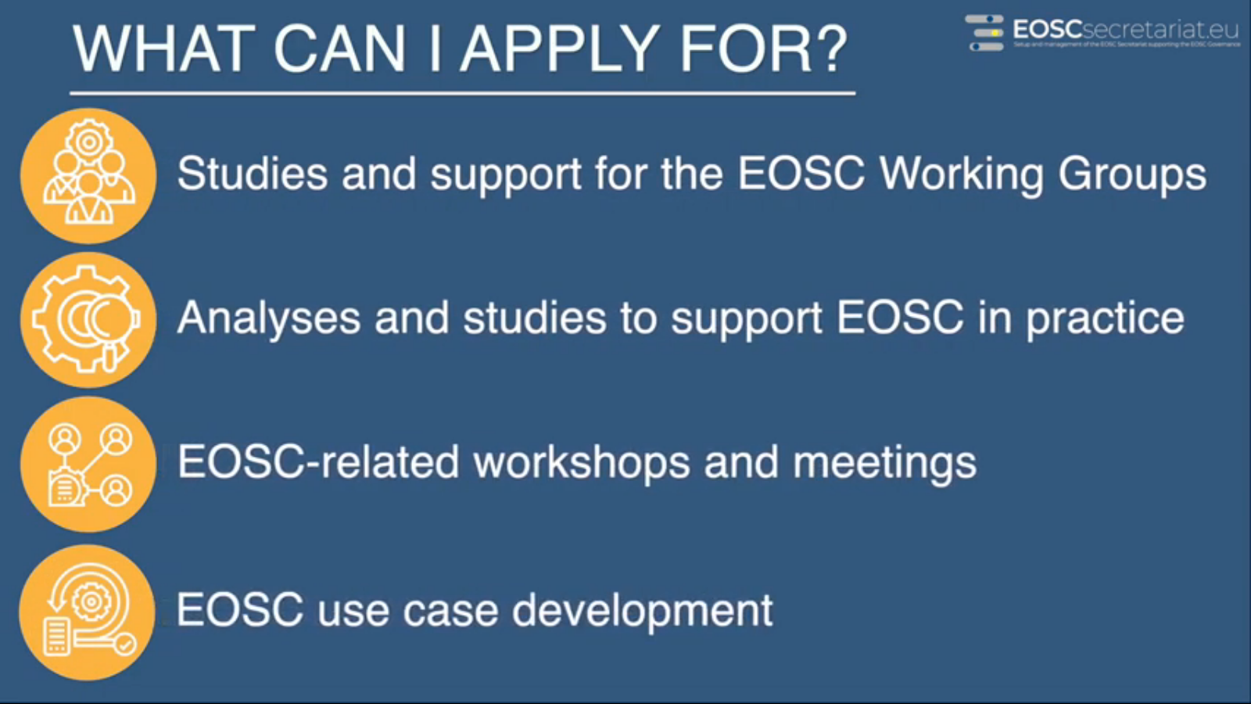

EOSCsecretariat Funding Opportunities for the Co-creation of EOSC
Do you have an idea that will help co-create the EOSC? Take the chance to get funding for your activity!
Learn more in the latest video from the EOSCsecretariat.eu
Three ways to apply:
Study Suggestions
Co-creation ideas and projects
Open Calls

Slide 9
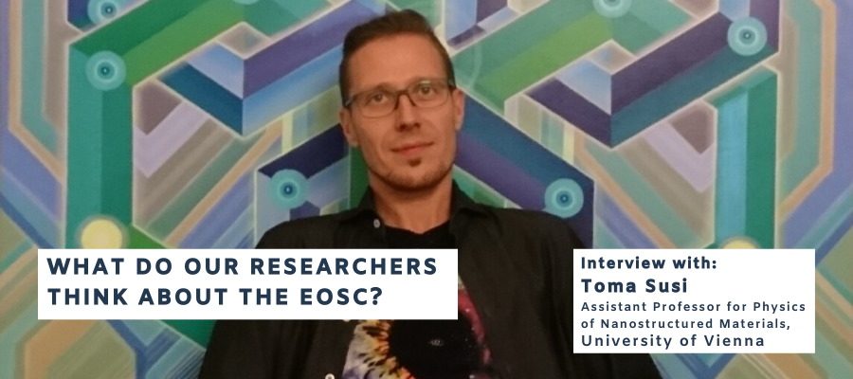

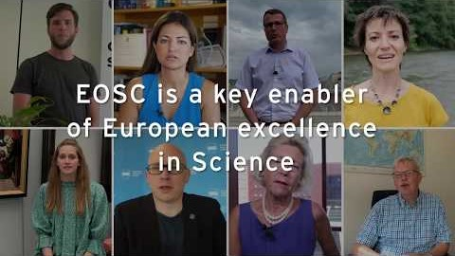
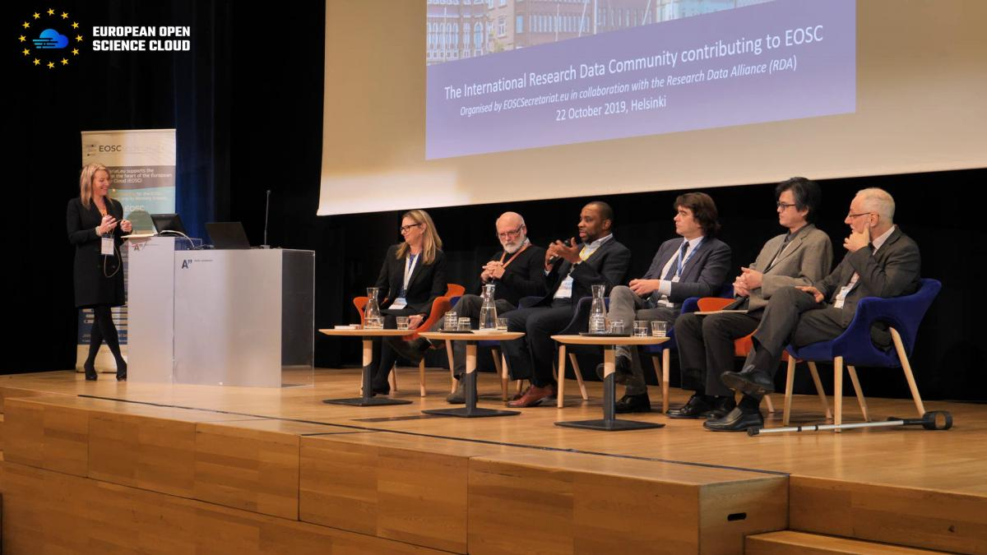
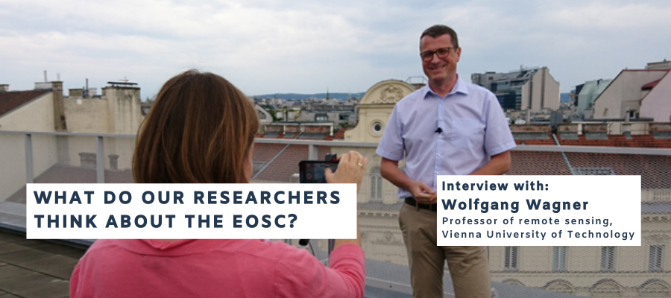






Contributions from our different stakeholders to the EOSC
Engagement with International Initiatives
Researcher engagement
Video: EOSC - The New Frontier of Data-Driven Science
Interviews
Workshops
The international Research Data Community Contributing to EOSC
EOSC Regional Projects - Coming Soon
EOSCsecretariat.eu just launched its Zenodo community, where all publications will be collected, in a collaborative and curated manner.
ESFRI Cluster projects – Position Papers
EOSC Symposium 2019 - Highlights
Building the European Open Science Cloud
HPC Assets and Contributions to the EOSC
EOSC 5b projects (Regional)

Slide 10


Stakeholder Engagement Opportunities
EOSC Executive Board Consultation Day @EOSC-hub week, 18 May 2020, Karlsruhe, Germany
EOSC Symposium 2019
+300 participants
37 Countries represented
49% from Academia /Research
EOSC Symposium 2020, October 2020, Germany
Final policy event, December 2020, Germany

Slide 11












Engage with the EOSCsecretariat.eu and
Contribute to help Co-Create EOSC!
TGB
UKRI
ARC
CERN
CNR-ISTI
GEANT
GO FAIR
KIT
TUWIEN
Trust-IT
CSC

