Slide 1
European Open Science Cloud
www.eosc-portal.eu
EOSC Launch Event | Vienna | 23rd Nov 2018

Slide 2
Introduction
EOSC Launch Event | Vienna | 23rd Nov 2018

Slide 3
The vision
The EOSC Portal is part of the EOSC implementation roadmap as one of the expected “federating core” services contributing to the implementation of the “Access and interface” action line
It has been conceived to provide a European delivery channel connecting the demand-side and the supply-side of the EOSC and all its stakeholders

Slide 4
Launched in November 2018

Slide 5
The EOSC portal at a glance

Slide 6
Services & Resources
Discover and compare multiple resources and services
Access services and resources via a smooth authentication/ authorisation process with no need to create new credentials for authentication
Around 70 services published
Avg 7600 unique visits x month
7 thematic disciplines

Slide 7
Join as a service provider
Publish, share and advertise services and resources to a wider user base;
Get statistics about access requests and customer feedback;
Get a free online platform where providers can manage service requests, interact with users and provide support to them, and agree the most suitable service levels;
Allow users to authenticate with existing credentials to access services and resources and get support to enable this;
Contribute to the definition and maintenance of EOSC service provisioning policies and the portfolio roadmap

Slide 8
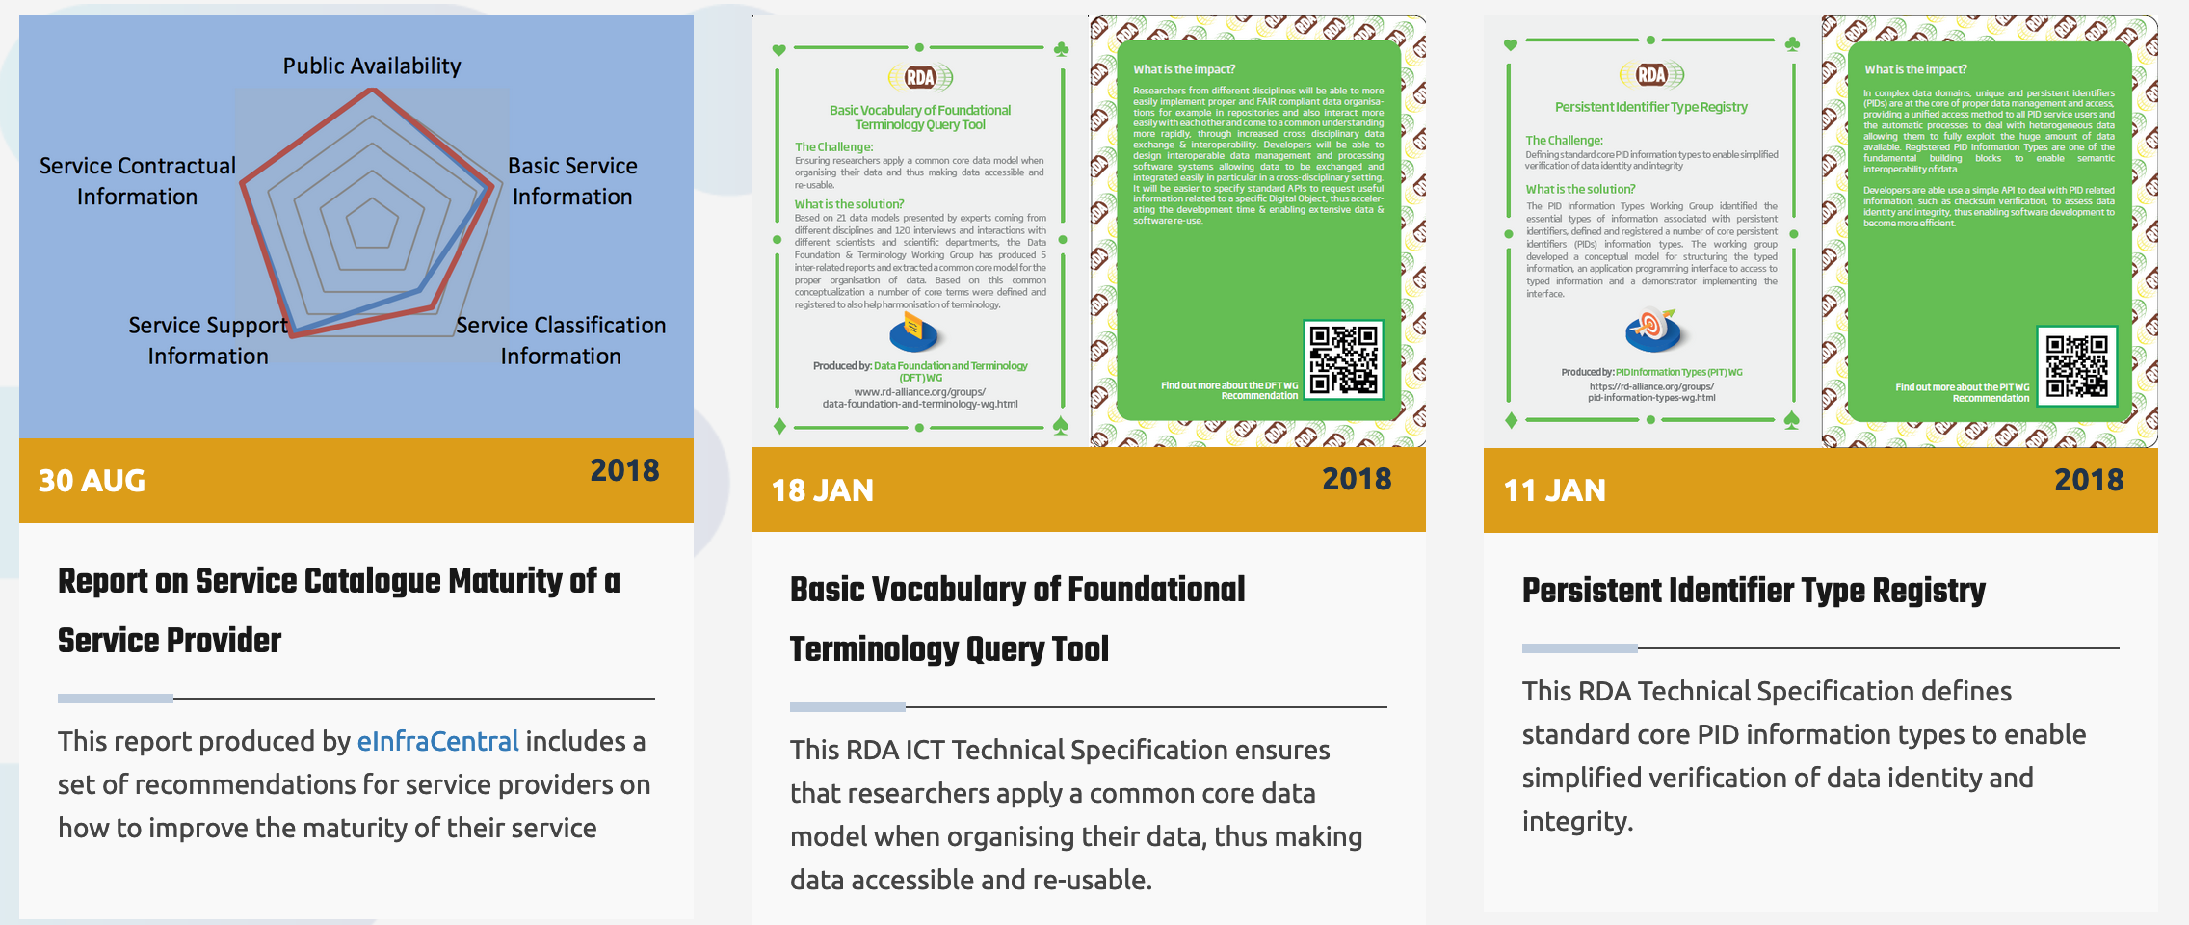
Visibility opportunities
Use Cases
Best Practices
www.eosc-portal.eu/eosc-in-practice/open-call

Slide 9
Funding opportunities
www.eosc-portal.eu/about/funding-opportunities

Slide 10
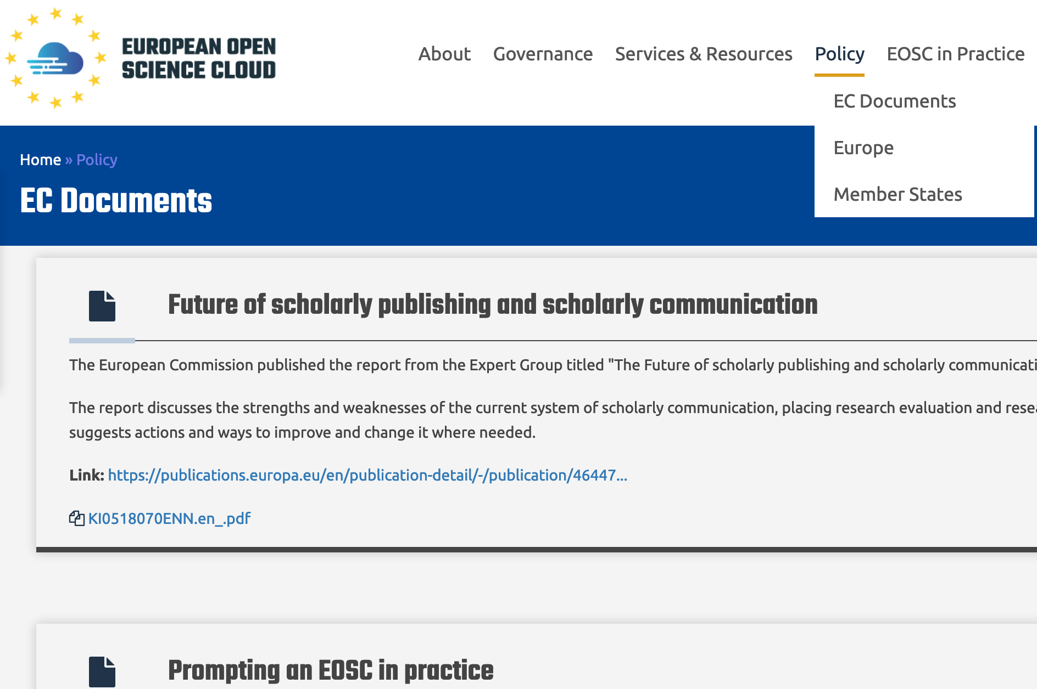
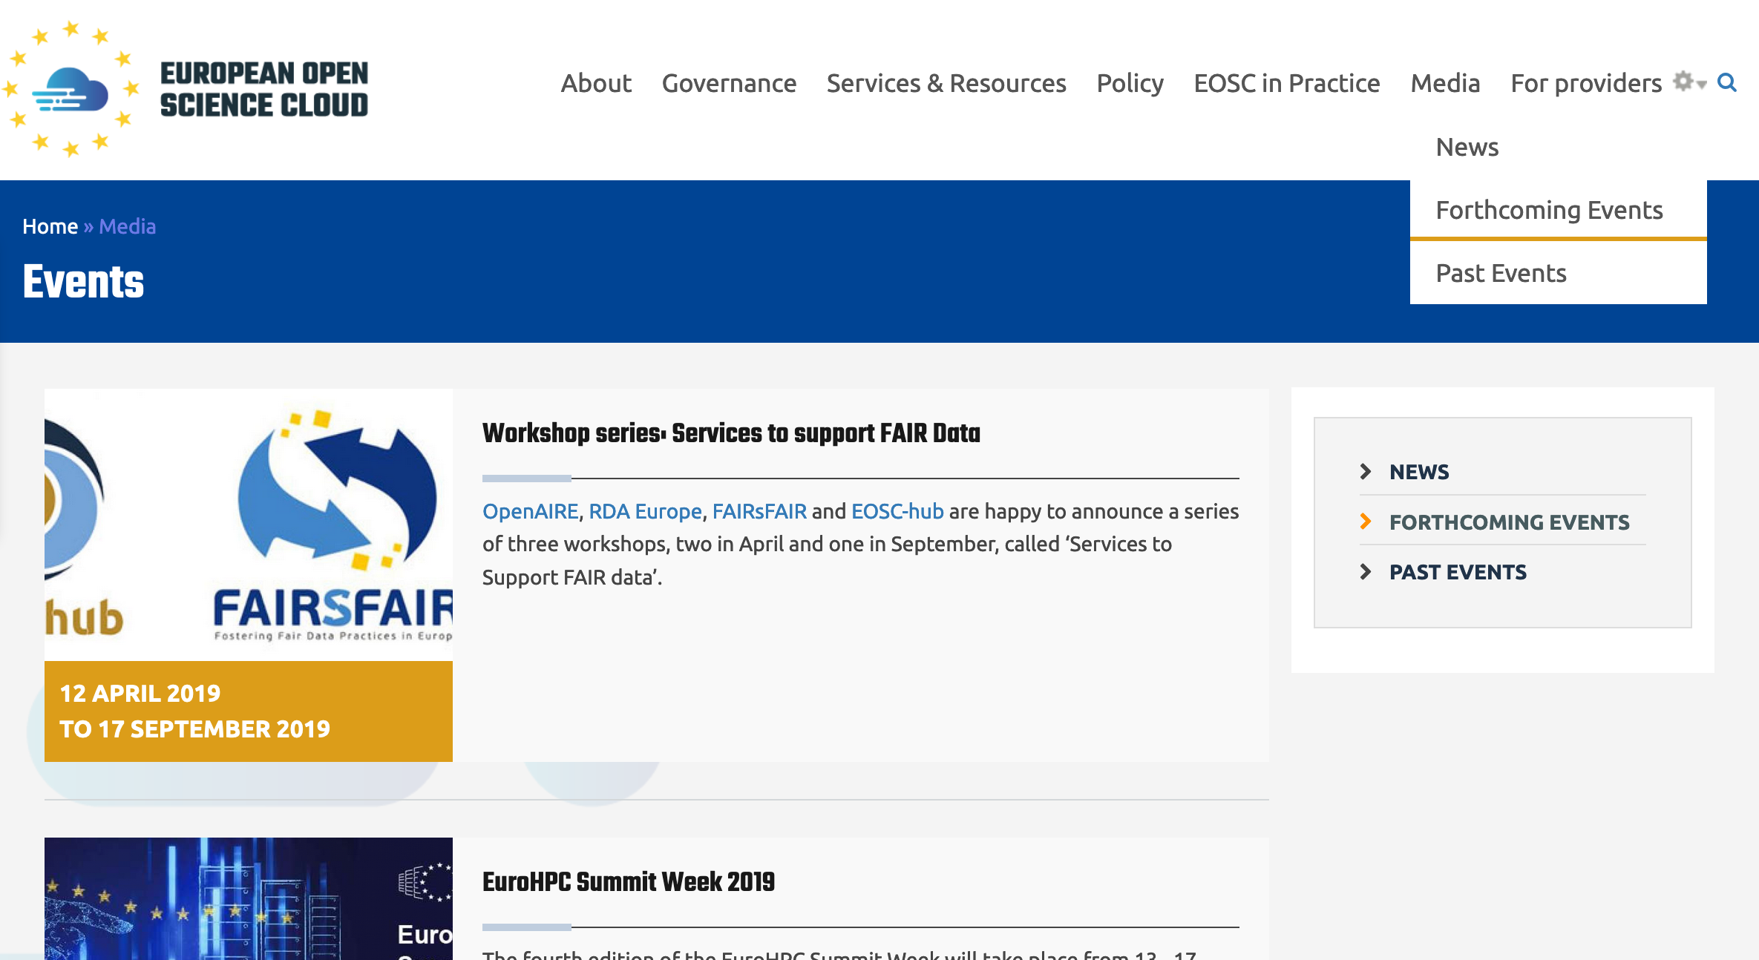
All you need to know about EOSC

Slide 11
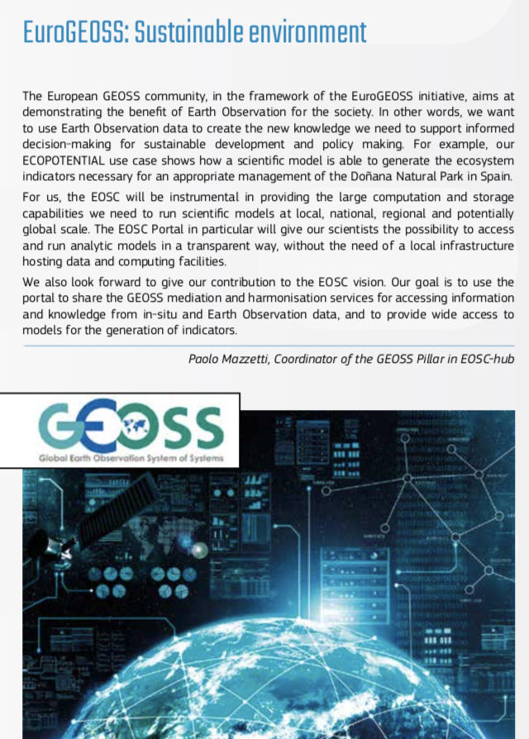
And much more…

Slide 12
www.eosc-portal.eu
@EOSCportal

